Slide 1
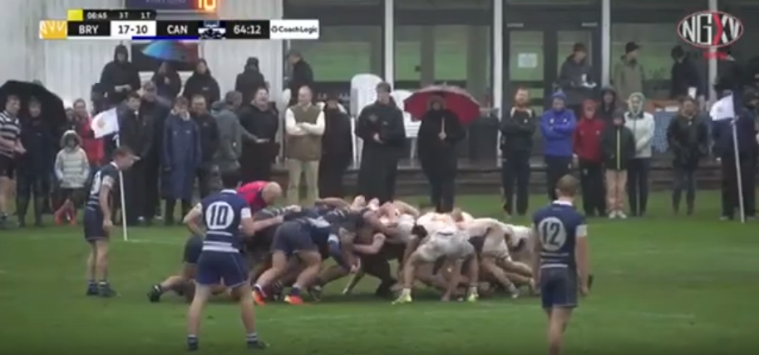
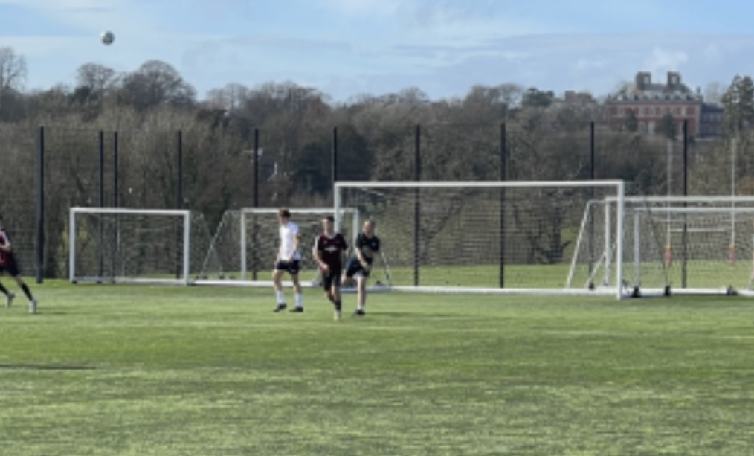

Personal Introduction & How Has This Work Experience Benefited You?
Benny Rochmankowski
Rugby
Football
Hockey
Double Bass
Film
Ivan Scivetti
Gilberto Teobaldi
Notes:
rug, foot, hoc, big cello, big guitar, film

Slide 2
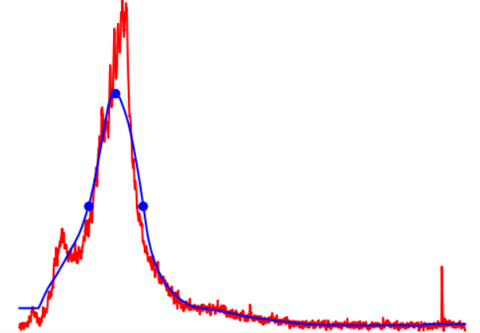
Stage 1 Projects: Group 1D: Peak Finding
Loss Signal
Smoothened Signal
Baseline
Height
FWHM
Notes:
Tell us:
What you contributed to your team / goals / tasks
Don’t forget update presentations, demo presentations, these presentations, communication tasks, documentations tasks – we focus on the product but this requires a vast amount of other contribution types (not just some python code)
Focus on a few things – remember you should aim to get this slide done in 30 – 45 seconds
What you learnt (if you want)
What you enjoyed or the opposite (if you want)
Your struggles and victories, personal and group / cohort (if you want)
Your self defined success (if you want)
Other interesting things (if you want)

Slide 3
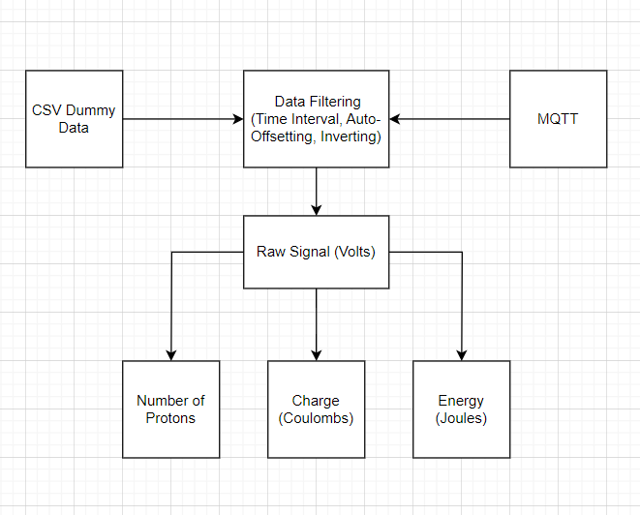
Stage 2 Projects: Waterfall GUI
Notes:
Tell us:
What you contributed to your team / goals / tasks
Don’t forget update presentations, demo presentations, these presentations, communication tasks, documentations tasks – we focus on the product but this requires a vast amount of other contribution types (not just some python code)
Focus on a few things – remember you should aim to get this slide done in 30 – 45 seconds
What you learnt (if you want)
What you enjoyed or the opposite (if you want)
Your struggles and victories, personal and group / cohort (if you want)
Your self defined success (if you want)
Other interesting things (if you want)

